Slide 1

The Long Period Record (New Edition)
By Aras Pirbadian
MMT Group
September 12th 2014

Slide 2
Index
Previous Vs Current Edition
Maxima and Minima
New Filters
Block Diagram for Filtering
Verifying the Results
Python 2.7 and Extra Packages Needed
Bat File and Control Variables

Slide 3
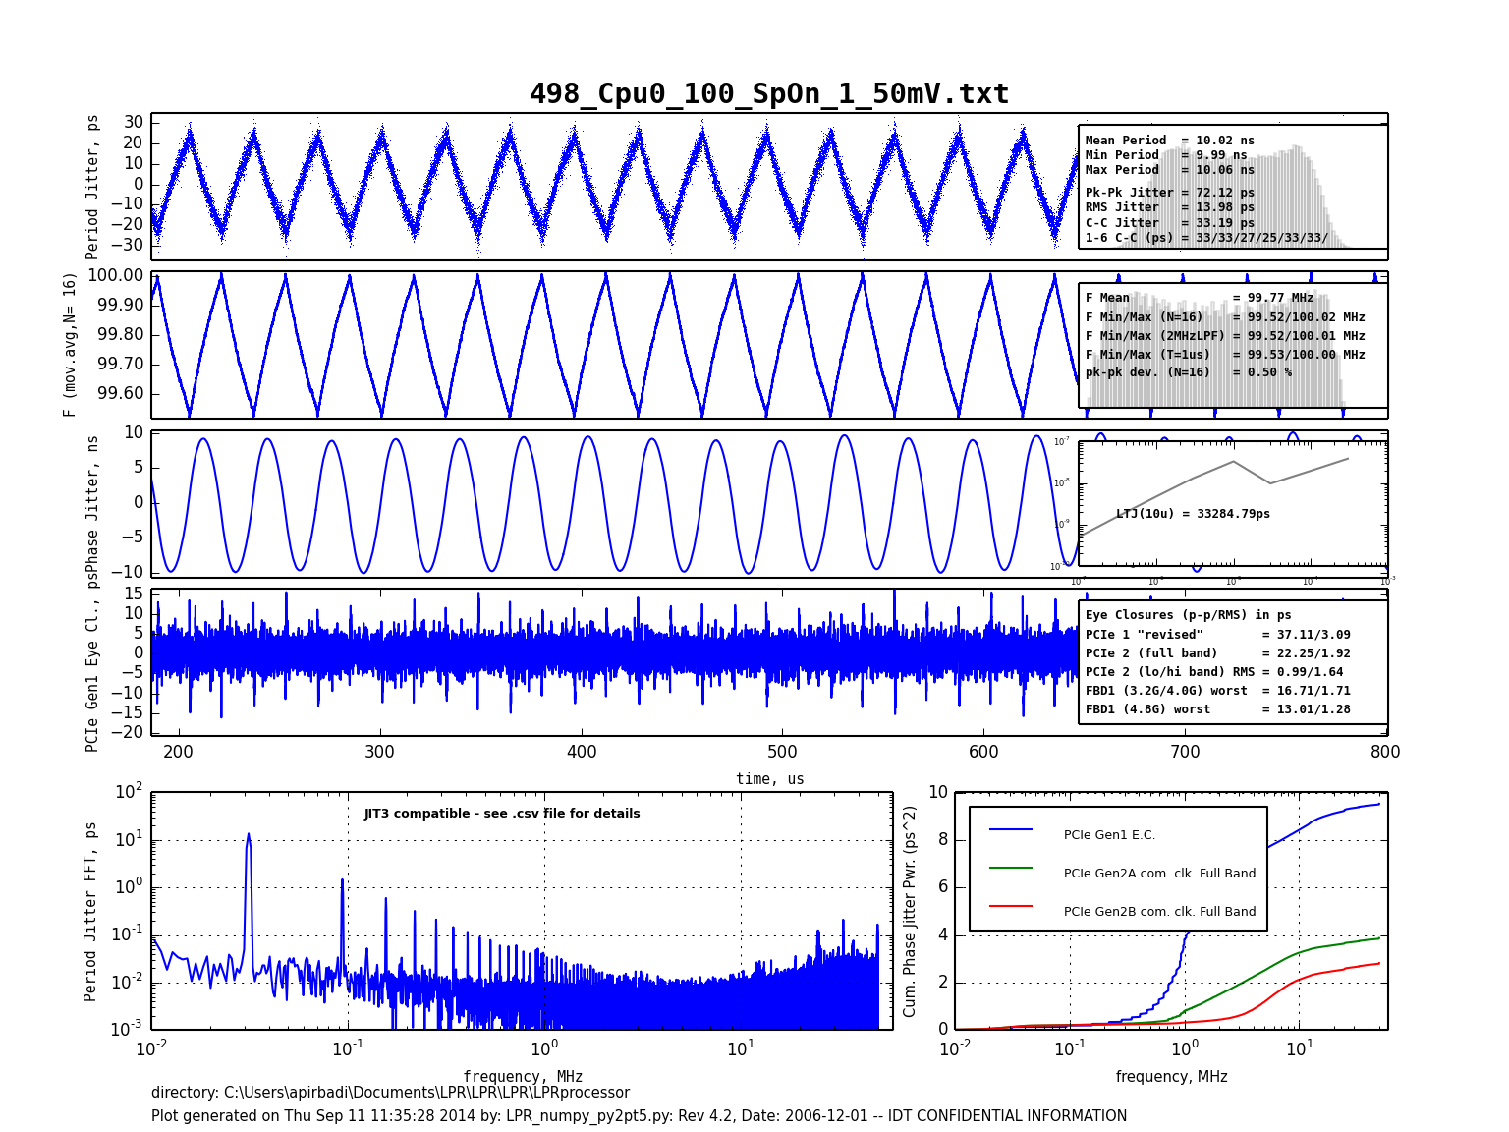

Slide 4
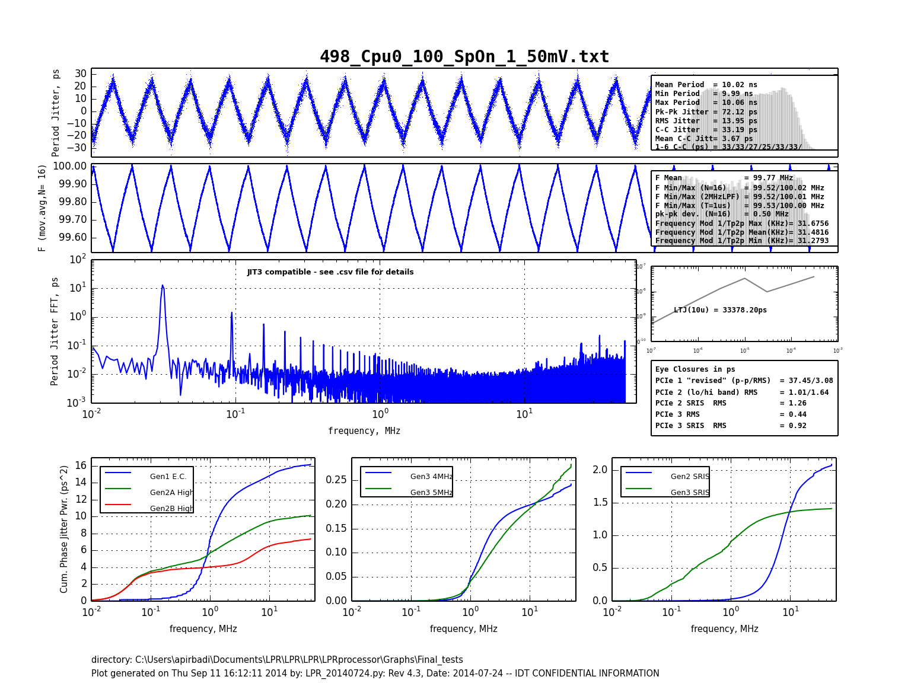
c

Slide 5
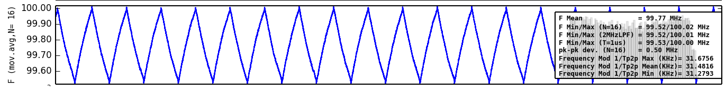
Maxima and Minima
Calculates the Max, Mean and Min of the local Maximums
Calculates the Max, Mean and Min of the local Minimums
Calculates the Max, Mean and Min of the 1/Tp2p

Slide 6
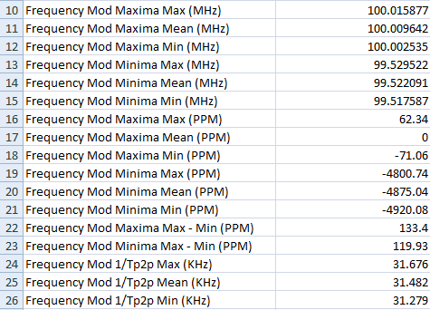

Maxima and Minima
PPM calculations
All PPMs are calculated based on the mean of maxima
Third argument in the bat file controls whether maxima and minima would be printed

Slide 7
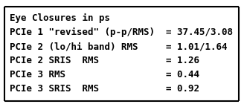
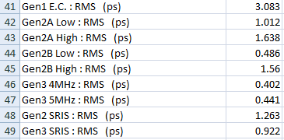
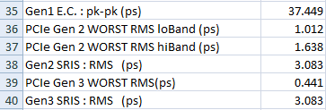
New Filters
Gen 2 SRIS
Gen 3 Common Clock
Gen 3 SRIS

Slide 8
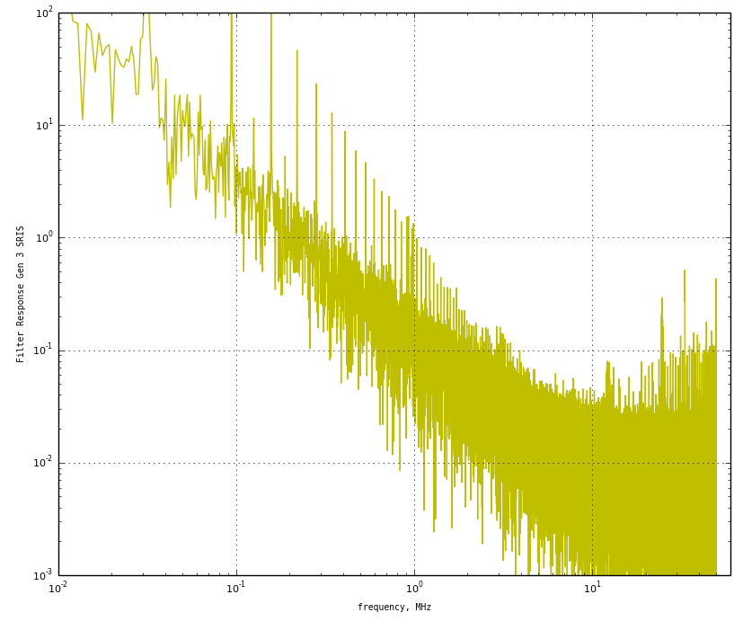
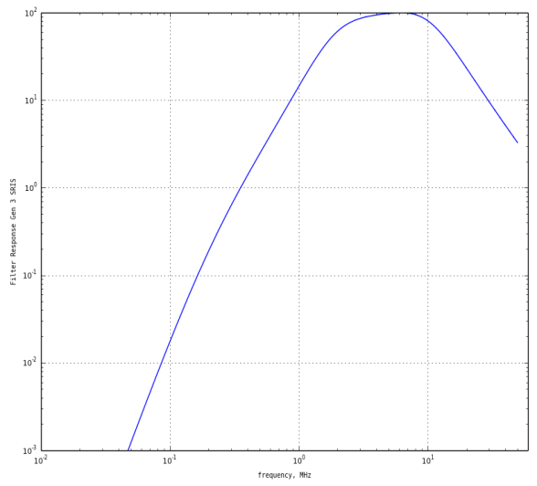
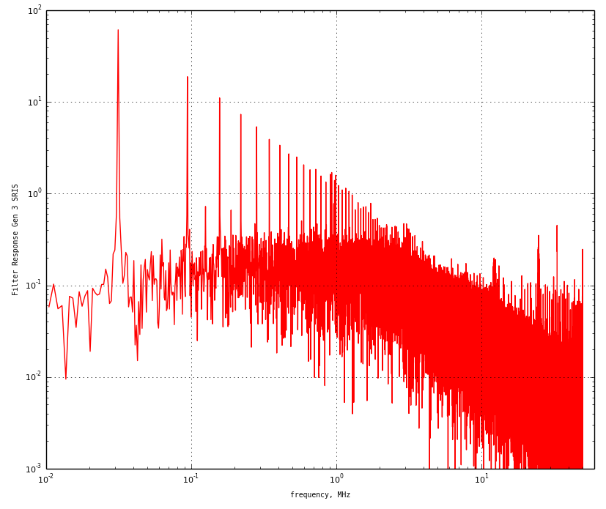
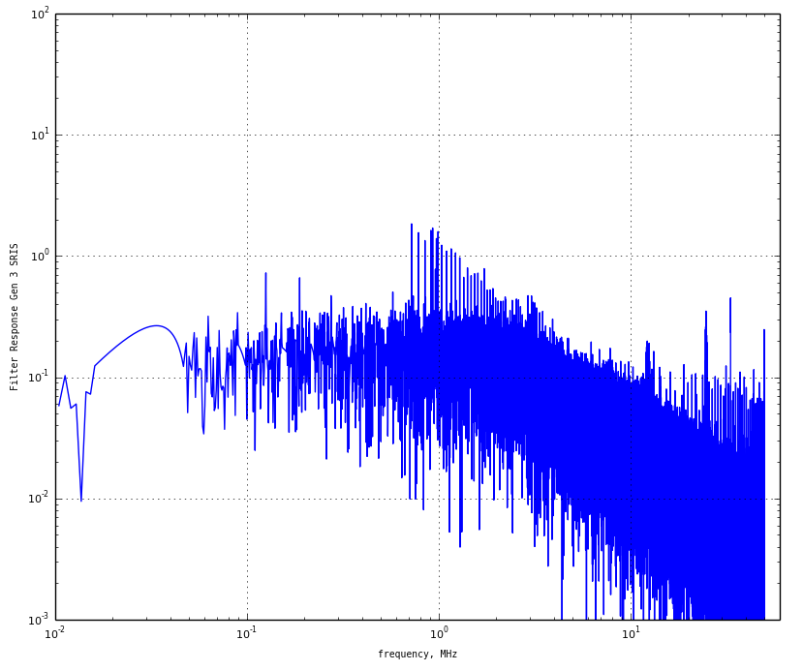
Filtering Block Diagram
Phase Jitter
FFT
X
Multiply by The Filter
Converts to Frequency Domain
Frequency Representation of Phase Jitter
Filter Response
IFFT
Eye Closure Diagram
Remove Spread Spectrum
Converts Back to Time Domain

Slide 9
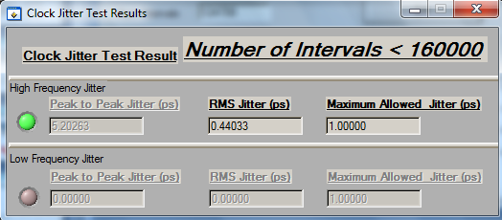
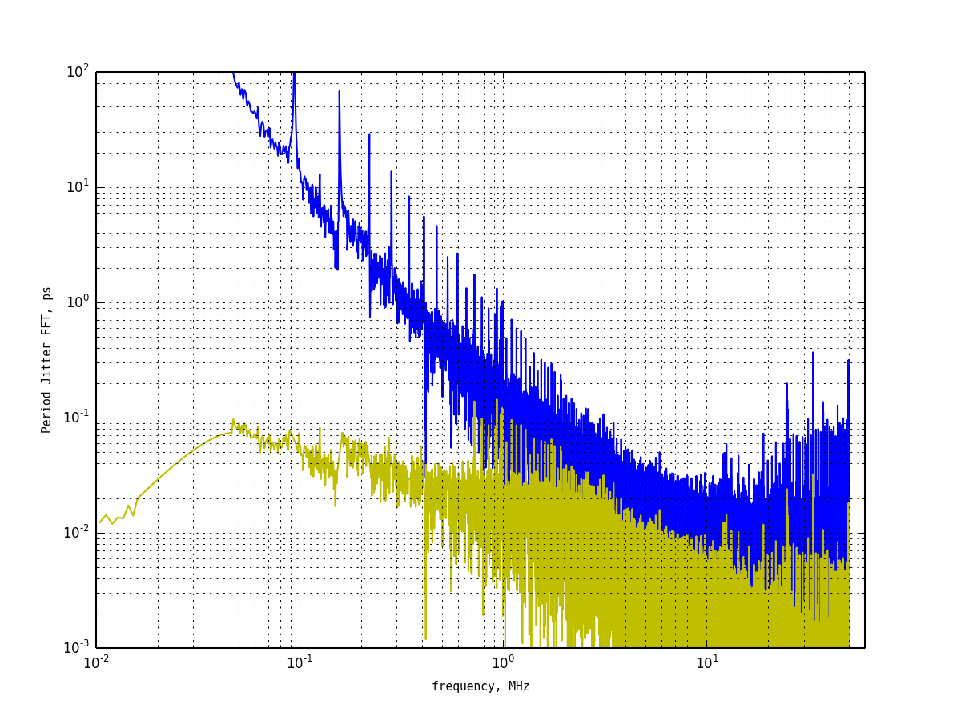
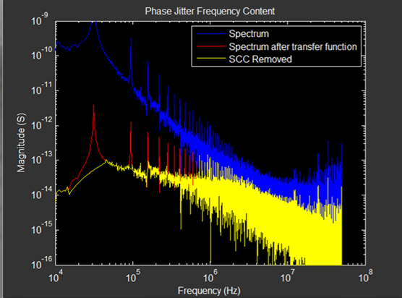
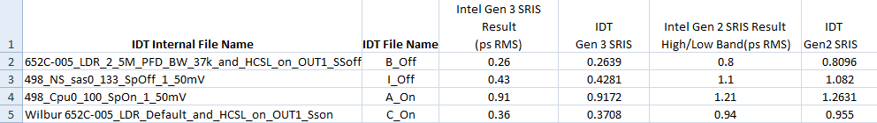
Verifying the Results

Slide 10
Python 2.7 and Extra Packages Needed
The new code uses Python 2.7
Packages needed are under S:\DAN\Python_Revised\Python_27_Packages
python 2.7
numpy
matplotlib
six
dateutil
Pyparsing
http://matplotlib.org/downloads.html
http://www.lfd.uci.edu/~gohlke/pythonlibs/
Don’t Forget to add Python to your Path!!

Slide 11


Bat File and Control Variables
ProcessNewTXT_2014
Maxima Print?
PythonLPR_2014
The 3rd Argument controls the calculation of the Maxima and Minima.

Slide 12
Thank You!

